Slide 1
Introduction to Statistics for Data Analytics
© Oluwatosin Oluwadare, Ph.D. 2023
Department of Computer Science , University of Colorado, Colorado springs.
CS 2020 and dase 2020
Introduction to statistics for data analystics
Spring 2023
Lecture 5: Summary Statistics and Regression I

Slide 2
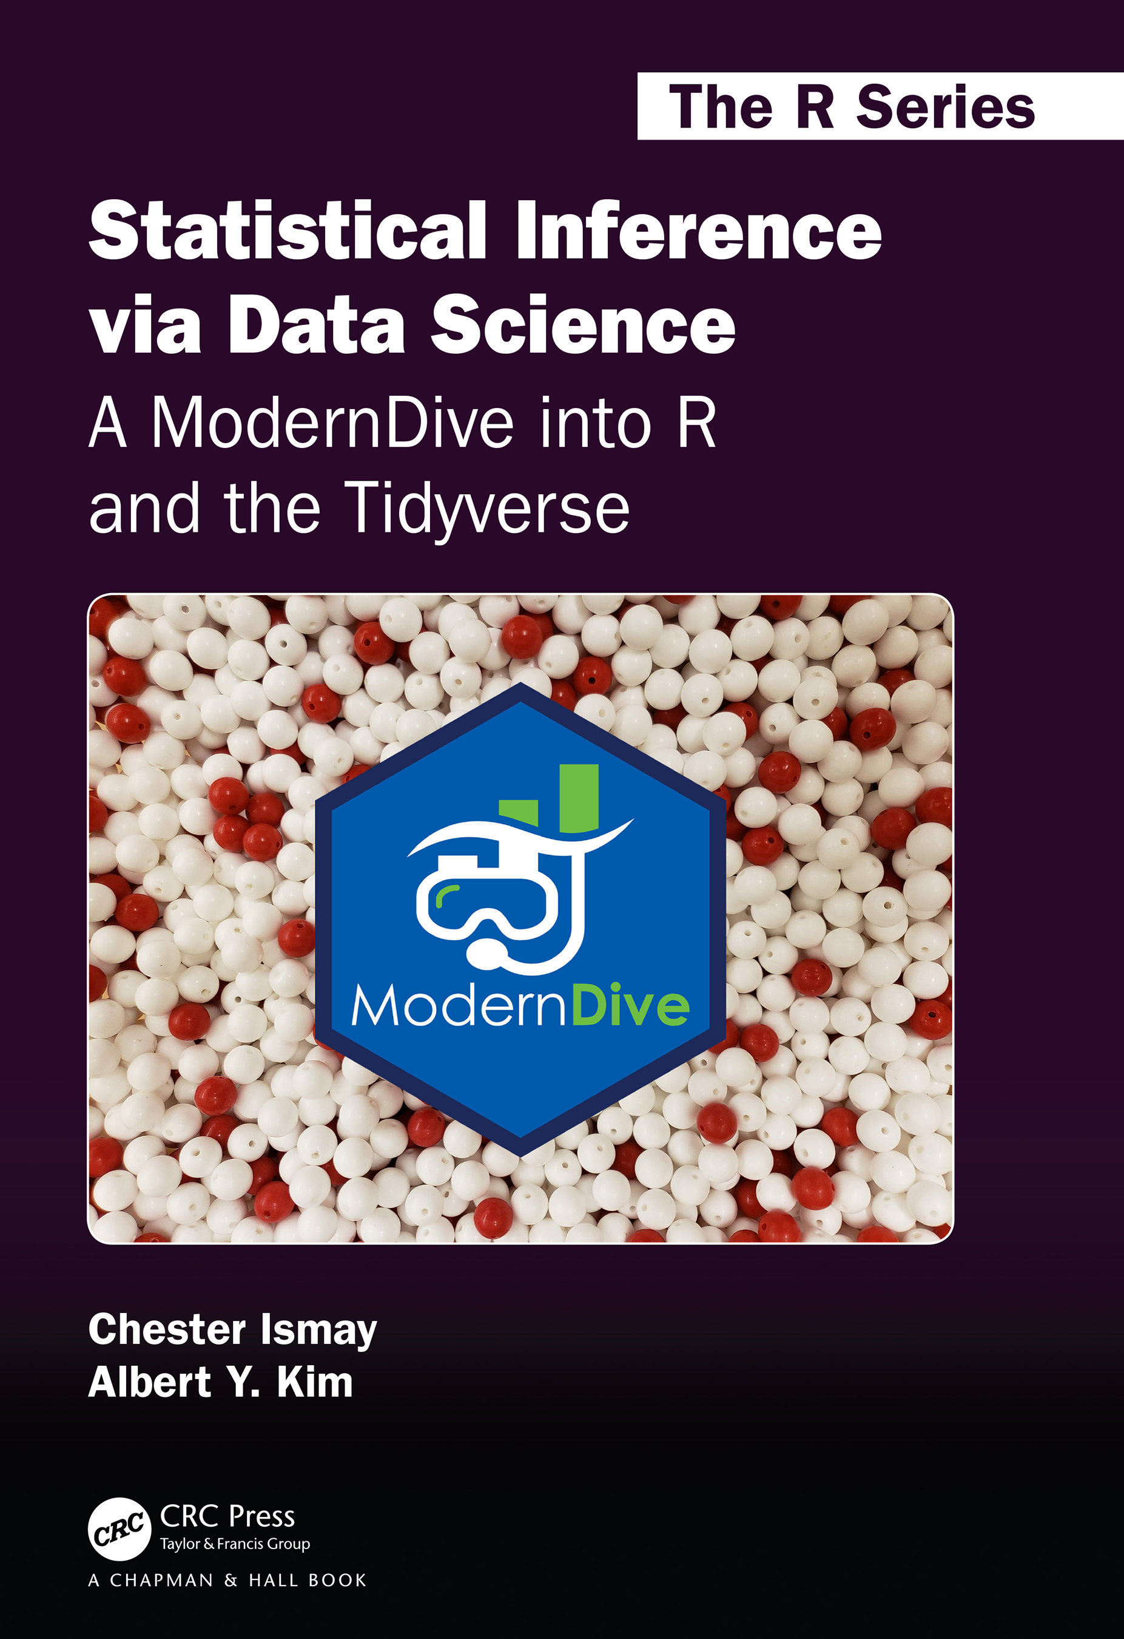
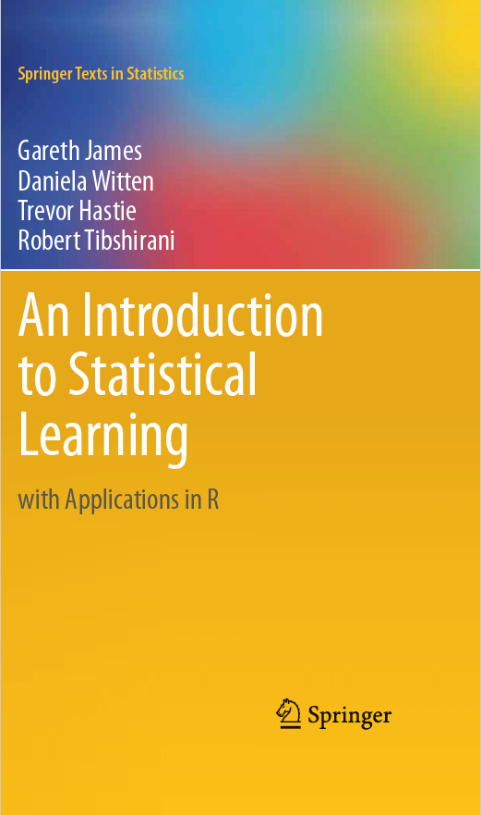
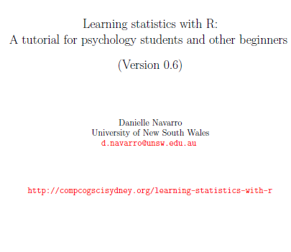
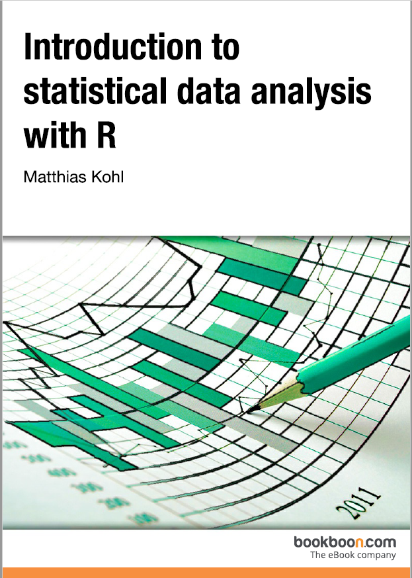
Credits
Our Main Textbook for the course:
  Ismay, Chester, and Albert Y. Kim. Statistical inference via data science: A ModernDive into R and the tidyverse. Chapman and Hall/CRC, 2019. Get an electronic copy from the UCCS Library. Or
  See open source copy of the textbook here: https://moderndive.com/ .
Some materials are from Michael Friendly
Stephanie Glen. "Inferential Statistics: Definition, Uses“
MiniTab
UCCS CS Dr. Adham Atyabi

Slide 3
Outline
Measures of central tendency
Measures of variability
Skew and kurtosis
Getting an overall summary of a variable
Descriptive statistics separately for each group
Standard scores
Correlations

Slide 4
Descriptive vs Inferential Statistics
What is the difference between inferential and descriptive statistics?
Let's assume you stand in the mall and ask 1000 people if they like to shop at Dillard’s
  Descriptive Statistics: Make a bar chart of yes/no responses
    It describes data
  Inferential Statistics: Infer that a 75+% of the population (all shoppers in all malls) like shopping at Dillard’s
    Make inferences form data (from a pool) to make generalization.
    Make hypothesis based on data

Slide 5
Descriptive vs Inferential Statistics
Main areas of inferential statistics:
  Estimating parameters. Taking a statistic from your sample data (e.g., the sample mean) -> the population mean.
  Hypothesis tests. Use sample data to answer research questions.
    Example: Using hypothesis test to test the efficacy of a newly developed drug or the impact of sleeping hours on daily performance

Slide 6
Descriptive vs Inferential Statistics
Consider a sample data for a new Covid drug obtain from a test population
Descriptive statistics useful for describing your sample data (specifically focused on the sample) include:
  Sample mean
  Sample standard deviation
  Making a bar chart or boxplot
  Describing the shape of the sample probability distribution

Slide 7
Descriptive vs Inferential Statistics
Inferential Statistics can be used to predict the effectiveness of the drug for a larger population based on the sample population findings by computing e.g. Z score, T score, and F-ratio
  Z-score: asking how many standard deviation a datapoint is from the mean distribution or where data would lie on a bell-cuve.
    To determine whether a specific sample is representative of its population, or is extreme and unrepresentative.

Slide 8
Descriptive Statistics
install.packages(‘lsr’)
library(lsr)
download.file("https://github.com/djnavarro/psyr/blob/master/data/aflsmall.Rdata","aflsmall.Rdata")
load("aflsmall.Rdata")
# see the variables stored in the file
who()
-- Name -- -- Class -- -- Size --
afl.finalists factor 400
afl.margins numeric 176

Slide 9
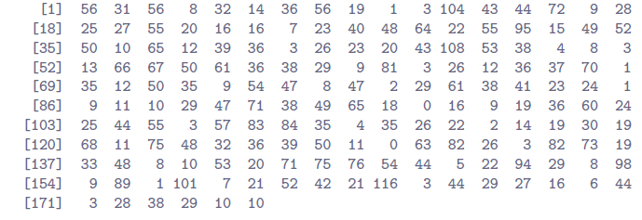
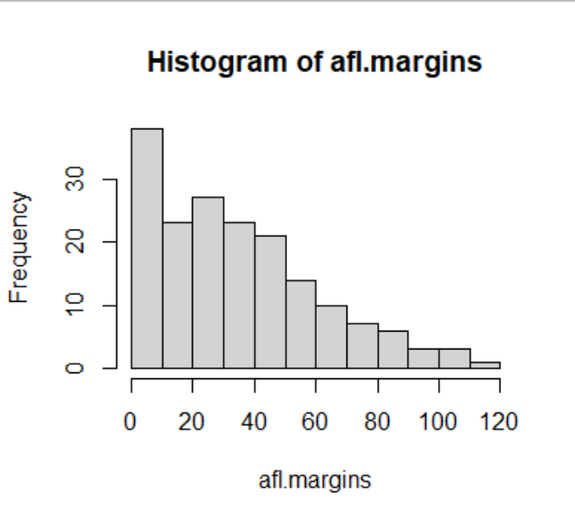
Descriptive Statistics
> print(afl.margins)
> hist(afl.margins)

Slide 10
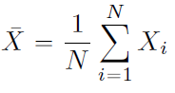
Measures of Central Tendency
Mean :
sum(c(56, 31, 56, 8, 32))/5
sum( afl.margins[1:5] ) / 5
mean(c(56, 31, 56, 8, 32))
mean( afl.margins[1:5] )
Number of observations N = 5
Median
sort(c(56, 31, 56, 8, 32))[3]
how about if N = 6: 8; 14; 31; 32; 56; 56
median( x = afl.margins )

Slide 11
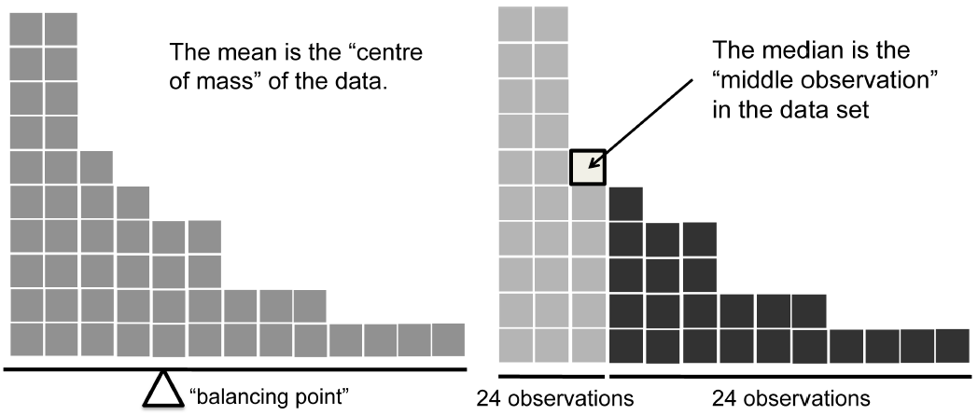
Measures of Central Tendency
The mean is kind of like the center of gravity of the data set
The median is the middle value in the data.

Slide 12
Measures of Central Tendency
Nominal Scale data: Mode modeOf( x = afl.finalists )
Ordinal Scale Data: Median
Interval and Ratio scale Data: Mean
How About Trimmed Mean?
  Like the Median: Not highly influenced by extreme outliers,
  Like the Mean, Use more than one of the observations
  mean( x = afl.margins, trim = .1)

Slide 13
Trimmed Means
dataset <- c( -15,2,3,4,5,6,7,8,9,12 )
mean( x = dataset )
[1] 4.1
median( x = dataset )
[1] 5.5
mean( x = dataset, trim = .1)
[1] 5.5
trim | the fraction (0 to 0.5) of observations to be trimmed from each end of x before the mean is computed. Values of trim outside that range are taken as the nearest endpoint.

Slide 14
Measures of variability
Range
  X.max = max( afl.margins )
  X.min = min( afl.margins )
  (X.max – X.min)
> range( afl.margins )
[1] 0 116
Range is a measure of variability but not a good one
  -100; 2; 3; 4; 5; 6; 7; 8; 9; 10 → range is 110
  2; 3; 4; 5; 6; 7; 8; 9; 10 → range is 8

Slide 15
Measures of Variability
Interquartile range (IQR)
  IQR is the range covered by that middle half of the data
  the median is the 50th percentile.
  > quantile( x = afl.margins, probs = .5)
  50%
  30.5
  > quantile( x = afl.margins, probs = c(.25,.75) )
  25% 75%
  12.75 50.50
  50.50-12.75 → 37.75
  > IQR( x = afl.margins )
  [1] 37.75

Slide 16
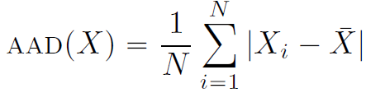
Measures of Variability
Measure the spread of the data by looking at the quantiles of the data
Select a meaningful reference point (mean or median), report the typical deviations from that reference point.
Mean absolute deviation (AAD)
  X=c(56, 31, 56, 8, 32)
  M=mean(X) # 36.6
  Dev=X-M
  AbsDev=abs(Dev)
  mean(AbsDev)
  mean( abs(afl.margins - mean(afl.margins)) )
  [1] 21.10124
Median absolute deviation (MAD)
  X=c(56, 31, 56, 8, 32)
  M=median(X) # 32
  Dev=X-M
  AbsDev=abs(Dev)
  median(AbsDev)
  median( abs(afl.margins - median(afl.margins)) )
  [1] 19.5
  mad( x = afl.margins, constant = 1 )
  [1] 19.5

Slide 17
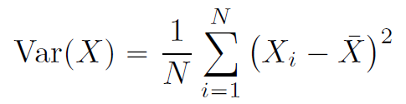
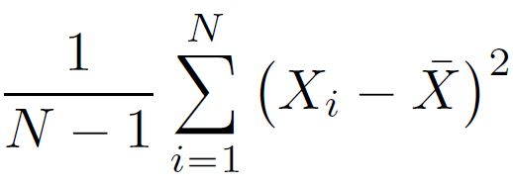
Measures of Variability
Mean absolute deviation (AAD)
Variance s²
  mean( (X - mean(X) )^2)
  Var(x)
  There is Weird N-1 issue in R
  formulation
  It’s the matter of Sample vs Population

Slide 18


Measures of Variability
Standard Deviation “s” “sd” “std dev”
R function to calculate standard deviation sd()
> sd( afl.margins )
[1] 26.07364

Slide 19
Which measure to use?
Range.
  Gives the full spread of the data.
  High vulnerability to outliers
  Not often used unless you have good reasons to care about the extremes in the data.
Interquartile range.
  Tells you where the “middle half" of the data sits.
  It's robust,
  Complements the median.
  Used a lot.
Mean absolute deviation.
  Tells you how far “on average" the observations are from the mean.
  It’s very interpretable,
  It is less attractive to statisticians than the standard deviation.
  Used sometimes, but not often.

Slide 20
Which measure to use?
Variance.
  Tells you the average squared deviation from the mean.
  It’s a way to describe variation around the mean
  it's uninterpretable because it doesn't use the same units as the data.
  It is mostly used as a mathematical tool
Standard deviation.
  This is the square root of the variance.
  It is expressed in the same units as the data
  It can be interpreted pretty well.
  This is by far the most popular measure of variation.
Median absolute deviation.
  The typical deviation from the median value.
  In the raw form it's simple and interpretable;
  In the corrected form it's a robust way to estimate the standard deviation, for some kinds of data sets.
  Not used very often, but it does get reported sometimes.

Slide 21

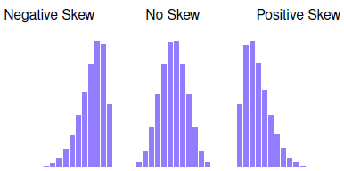
Skew
Skewness is a measure of asymmetry
> library( psych )
> skew( x = afl.margins )
[1] 0.7671555

Slide 22
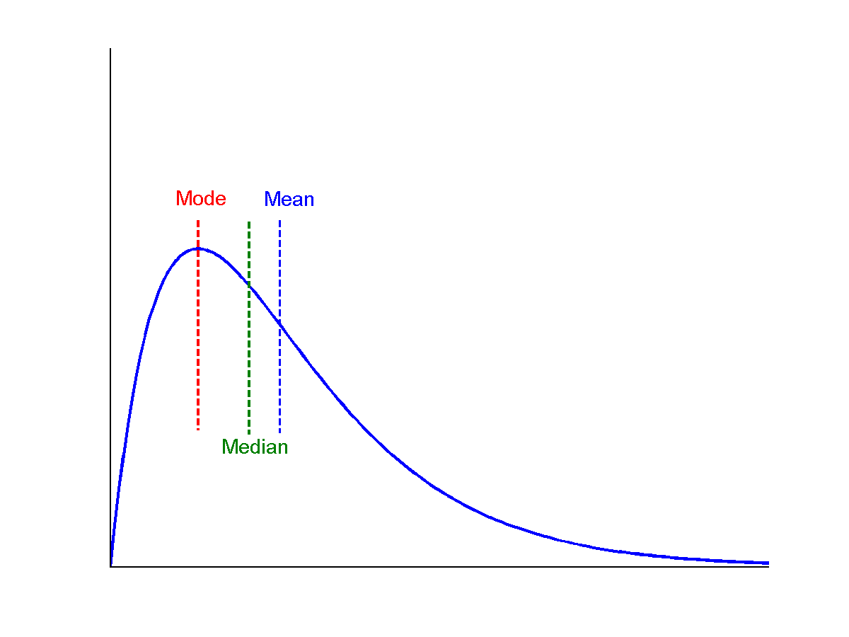
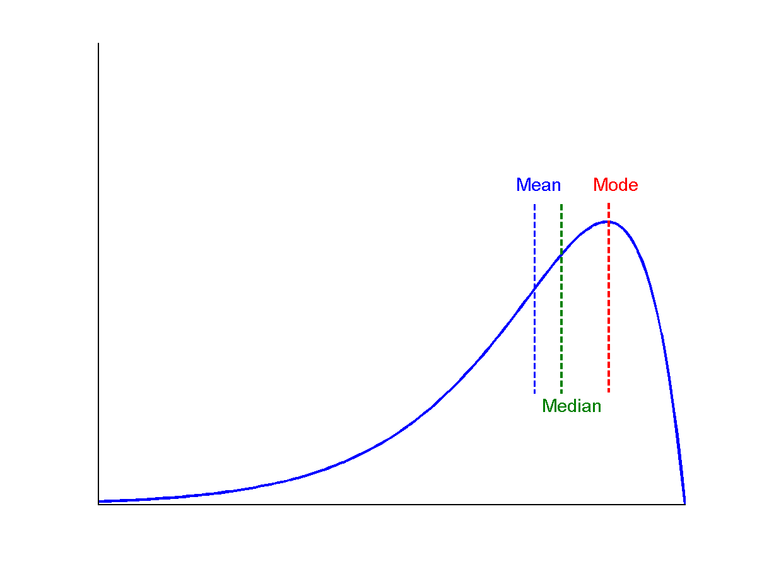
Symmetric vs. Skewed Data
Median, mean and mode of symmetric, positively and negatively skewed data
symmetric
positively skewed
negatively skewed

Slide 23
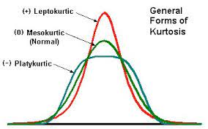

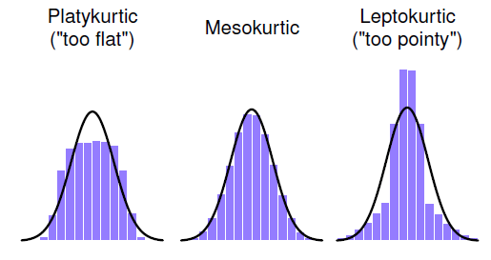
kurtosis
Kurtosis is a measure of the “pointiness” of a data set
> library( psych )
> kurtosi( x = afl.margins )
[1] 0.02962633

Slide 24
Summarization
summary() function prints out some useful information about the object you pass to it
> summary( object = afl.margins )
Min. 1st Qu. Median Mean 3rd Qu. Max.
0.00 12.75 30.50 35.30 50.50 116.00

Slide 25
Summarization
> blowouts <- afl.margins > 50
> blowouts
[1] TRUE FALSE TRUE FALSE FALSE FALSE FALSE TRUE FALSE FALSE
[11] FALSE TRUE FALSE FALSE TRUE FALSE FALSE FALSE FALSE TRUE
[21] FALSE FALSE FALSE FALSE FALSE FALSE FALSE TRUE FALSE TRUE
…..
> summary( object = blowouts )
Mode FALSE TRUE NA's
logical 132 44 0

Slide 26
Summarization
> summary( object = afl.finalists )
Adelaide Brisbane Carlton Collingwood
26 25 26 28
Essendon Fitzroy Fremantle Geelong
32 0 6 39
Hawthorn Melbourne North Melbourne Port Adelaide
27 28 28 17
Richmond St Kilda Sydney West Coast
6 24 26 38
Western Bulldogs
24
> f2 <- as.character( afl.finalists )
> summary( object = f2 )
Length Class Mode
400 character character

Slide 27
Summarization
> load("clinicaltrial.Rdata")
> who(TRUE)
-- Name -- -- Class -- -- Size --
clin.trial data.frame 18 x 3
$drug factor 18
$therapy factor 18
$mood.gain numeric 18
> summary( clin.trial )
drug therapy mood.gain
placebo :6 no.therapy:9 Min. :0.1000
anxifree:6 CBT :9 1st Qu.:0.4250
joyzepam:6 Median :0.8500
Mean :0.8833
3rd Qu.:1.3000
Max. :1.8000

Slide 28
Describing
The describe() function (in the psych package) is only intended for when your data are interval or ratio scale.
Unlike the summary() function, it calculates the same descriptive statistics for any type of variable you give it.
  var. This is just an index: 1 for the first variable, 2 for the second variable, and so on.
  n. This is the sample size: more precisely, it's the number of non-missing values.
  mean. This is the sample mean.
  sd. This is the (bias corrected) standard deviation.
  median.
  trimmed. This is trimmed mean. By default it's the 10% trimmed mean.
  mad. The median absolute deviation.
  min. The minimum value.
  max. The maximum value.
  range. The range spanned by the data.
  skew. The skewness.
  kurtosis. The kurtosis.
  se. The standard error of the mean.

Slide 29
Describing
The most recent development version of the package is always available for download as a source file from the repository at the PMC lab: install.packages("psych", repos = "https://personality-project.org/r/", type="source").
This will provide the most recent version for PCs and Macs.
Notes:
https://cran.r-project.org/web/packages/psych/psych.pdf

Slide 30
Describing
> describe(x=clin.trial)
vars n mean sd median trimmed mad min max range skew kurtosis se
drug* 1 18 2.00 0.84 2.00 2.00 1.48 1.0 3.0 2.0 0.00 -1.66 0.20
therapy* 2 18 1.50 0.51 1.50 1.50 0.74 1.0 2.0 1.0 0.00 -2.11 0.12
mood.gain 3 18 0.88 0.53 0.85 0.88 0.67 0.1 1.8 1.7 0.13 -1.44 0.13

Slide 31
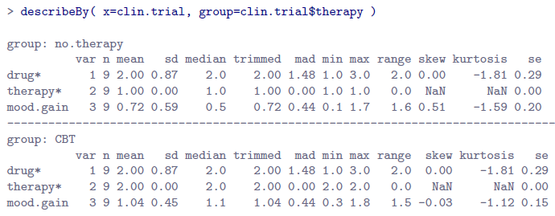
Descriptive Statistics + Grouping
by()
describeBy(): describeBy(x=clin.trial, group=clin.trial$therapy)
aggregate()

Slide 32
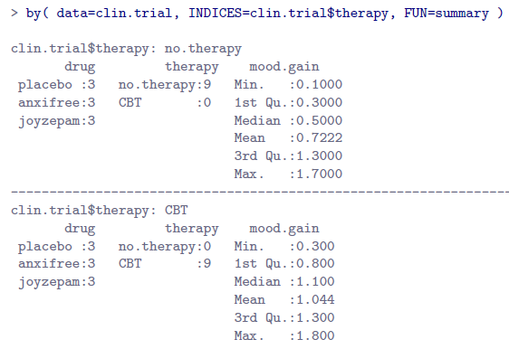
Descriptive Statistics + Grouping

Slide 33
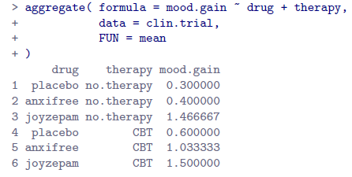
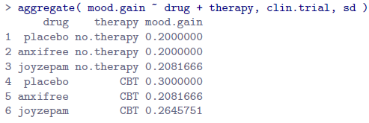
Descriptive Statistics + Grouping
mood.gain separately for each possible combination of drug and therapy: mood.gain ~ drug + therapy
calculate the standard deviations for each group

Slide 34
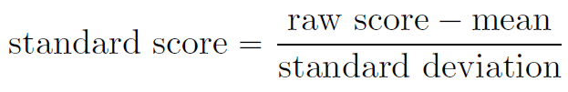
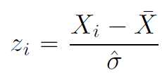
Standard Scores (z-score)
The standard score is defined as the number of standard deviations from the mean
Standard scores can be compared to one another in situations where the raw scores can’t.
Any normal distribution can be standardized by converting its values into z scores.

Slide 35
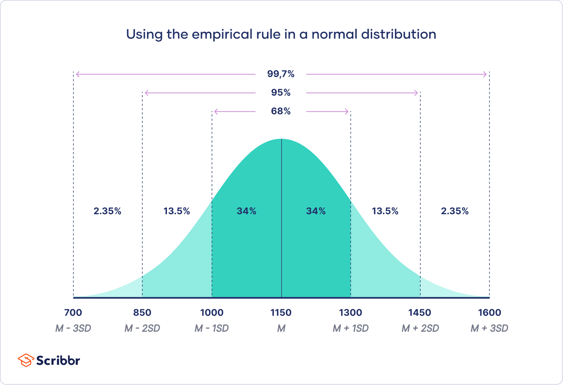
Properties of Normal Distribution Curve
The normal (distribution) curve
  From μ–σ to μ+σ: contains about 68% of the measurements (μ: mean, σ: standard deviation)
  From μ–2σ to μ+2σ: contains about 95% of it
  From μ–3σ to μ+3σ: contains about 99.7% of it

Slide 36
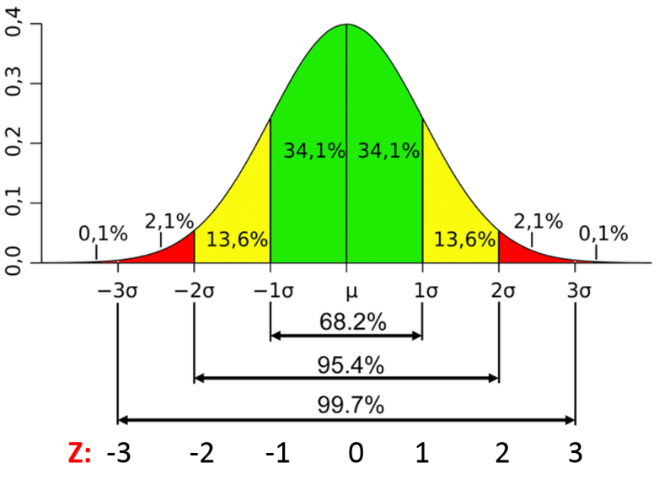
Standard deviation in a Normal Distribution
Images/google

Slide 37
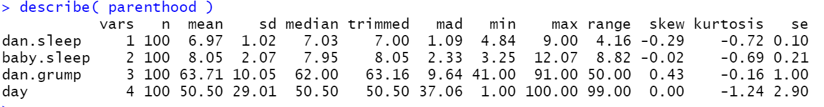
Correlations: Bi-variate summary statistics
> load( "parenthood.Rdata" )
> who(TRUE)
-- Name -- -- Class -- -- Size --
parenthood data.frame 100 x 4
$dan.sleep numeric 100
$baby.sleep numeric 100
$dan.grump numeric 100
$day integer 100
> parenthood
dan.sleep baby.sleep dan.grump day
1 7.59 10.18 56 1
2 7.91 11.66 60 2
3 5.14 7.92 82 3
4 7.71 9.61 55 4
BLAH BLAH BLAH
98 5.38 6.97 82 98
99 7.02 6.56 55 99
100 6.45 7.93 74 100

Slide 38
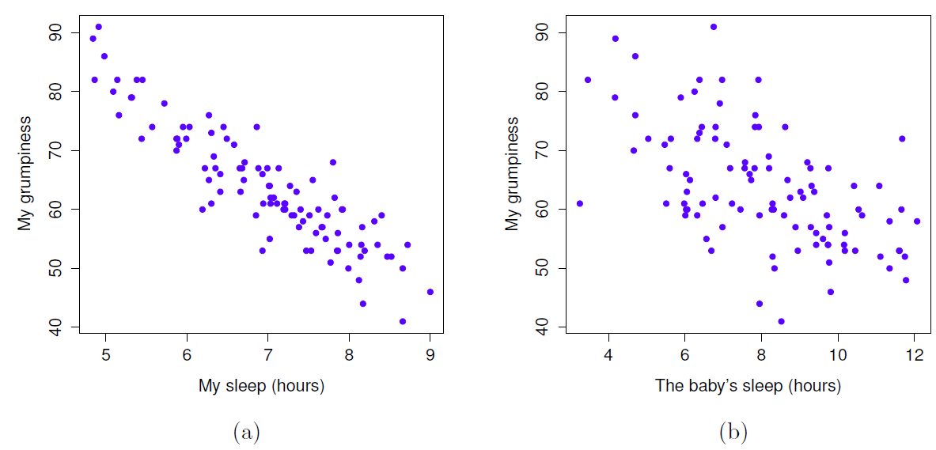
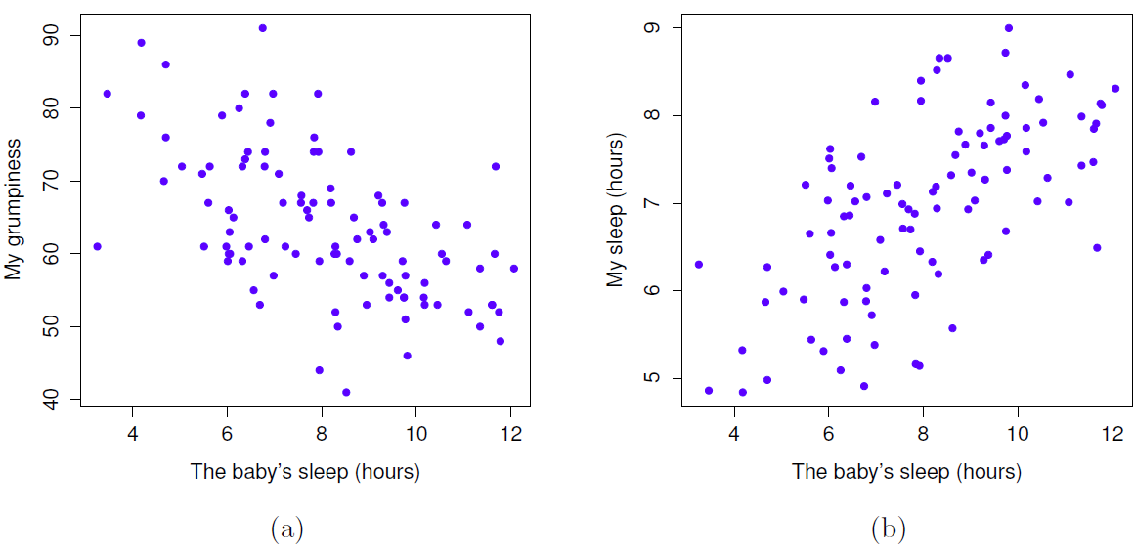
Correlations: Bi-variate summary statistics
Scatterplots offers a general sense of how closely related two variables are

Slide 39
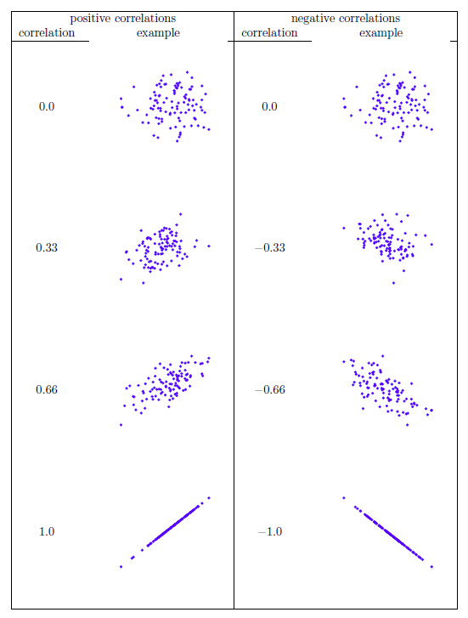
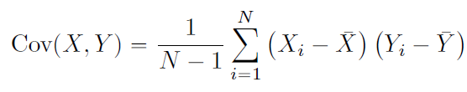
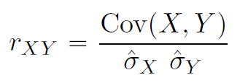
The Correlation Coefficient (r)
The covariance between two variables X and Y is a generalization of the notion of the variance
X and Y are unrelated → cov = zero
X and Y has positive relation → cov = positive
X and Y has negative relation → cov = negative

Slide 40
The Correlation Coefficient
> cor( x = parenthood$dan.sleep, y = parenthood$dan.grump )
[1] -0.903384
> # correlate all pairs of variables in "parenthood":
> cor( x = parenthood )
dan.sleep baby.sleep dan.grump day
dan.sleep 1.00000000 0.62794934 -0.90338404 -0.09840768
baby.sleep 0.62794934 1.00000000 -0.56596373 -0.01043394
dan.grump -0.90338404 -0.56596373 1.00000000 0.07647926
day -0.09840768 -0.01043394 0.07647926 1.00000000

Slide 41
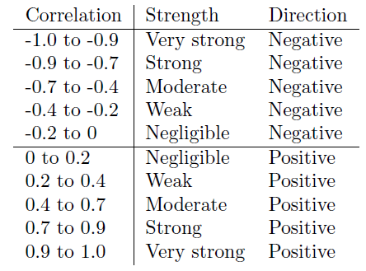
How to interpret Correlation data?
Is it natural to get correlation of 1 in real life data?
How you interpret a correlation results depend on
  what you want to use the data for?
  how strong the correlations in your field tend to be?

Slide 42
Pearson Correlations
A correlation coefficient measures the extent to which two variables tend to change together.
The coefficient describes both the strength and the direction of the relationship.
Pearson correlation coefficient measures the strength of the linear relationship between two variables
It provides a measure of the extent to which the data all tend to fall on a single, perfectly straight line
A relationship is linear when a change in one variable is associated with a proportional change in the other variable.

Slide 43
Spearman’s Rank Correlations
The Spearman correlation evaluates the monotonic relationship between two continuous or ordinal variables. In a monotonic relationship, the variables tend to change together, but not necessarily at a constant rate.
The Spearman correlation coefficient is based on the ranked values for each variable rather than the raw data.
Spearman correlation is often used to evaluate relationships involving ordinal variables.
It is always a good idea to examine the relationship between variables with a scatterplot. Correlation coefficients only measure linear (Pearson) or monotonic (Spearman) relationships. Other relationships are possible.

Slide 44
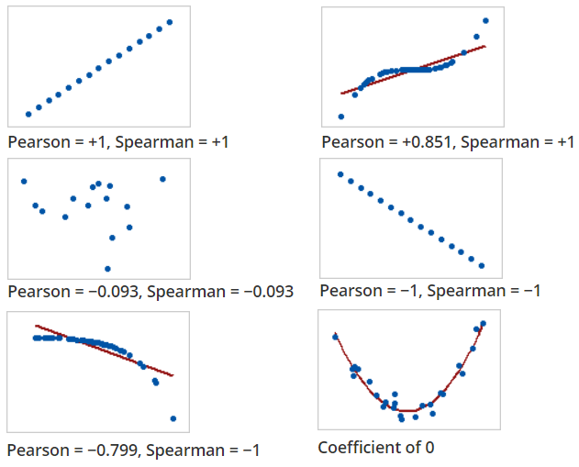
Spearman’s Rank Correlations

Slide 45
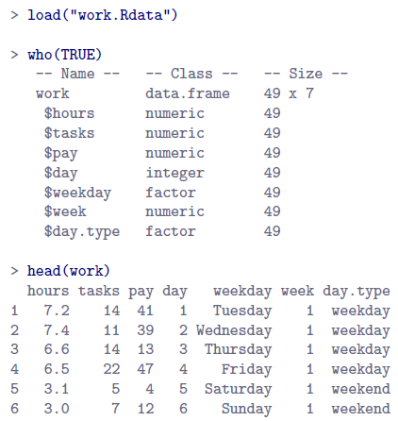
The Correlation Coefficient
cor() function spits out an error if you use it with non-numeric variables
Pearson and Spearman correlations are only designed to work for numeric variables, so the cor() function spits out an error.

Slide 46
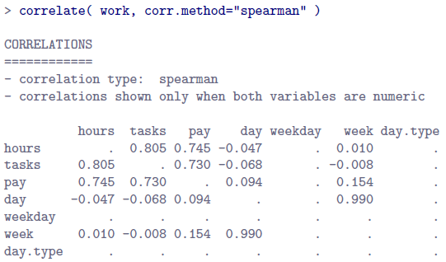
The Correlation Coefficient
> cor(work$hours,work$pay)
[1] 0.7604283
> cor(work)
Error in cor(work) : 'x' must be numeric
correlate() function in the lsr package can address this issue

Slide 47
Regression I:
Regression with one Numerical Variable
Chapter 5:
Statistical Inference via Data Science

Slide 48
In Class Reading and Discussion
Today’s reading is Chapter 5: Regression I
Sections 5 to 5.1.2
Assigned time: 20-25 mins. 3:25 pm – 3:50pm
Review Points for discussion (3:50pm - 4:00 pm)
Chalk Talk Discussion on Simple Linear Regression
  Fit the linear regression model to the data using lm() function
  lm(y ~ x, data = data_frame_name)

Slide 49
Simple Linear Regression
# Fit regression model:
> score_model <- lm(score ~ bty_avg, data = evals_ch5)
# Get regression table:
> get_regression_table(score_model)
Fit the Linear Regression Model
Obtain Regression Table from the model
Evaluate the statistical significance and practical significance of our results

Slide 50
In-Class Exercise (Submit Response on Canvas)
What are the three common steps in exploratory data analysis (EDA)?
Create a new data from the evals data frame with the following five variables only: ID, age, cls_did_eval, cls_students and score
Use two of the data frame exploring functions we have discussed in class (in previous lectures) to display the new data you created.
Using this new data, we have some questions: How does the instructor’s age, “young” or “old” influence the teaching evaluations? Or Could it be that younger professors have higher evaluations or Older professors have a higher evaluation?
To address this question, perform the EDA steps as explained in the textbook for the in-class reading of today. Using header, correctly label each steps of the EDA to show how you performed each step. Note: In step 2. (i) use the skimr() function (ii) also include a bi-variate summary statistics ( e.g. correlation coefficient )
Comment on the relationship you observed between the two variables based on the EDA outcome.

